Slide 1

Complete blood count
Youssif Assem, Kareem Ehab, Mohamed Moataz, Ahmed Gamal

Slide 2
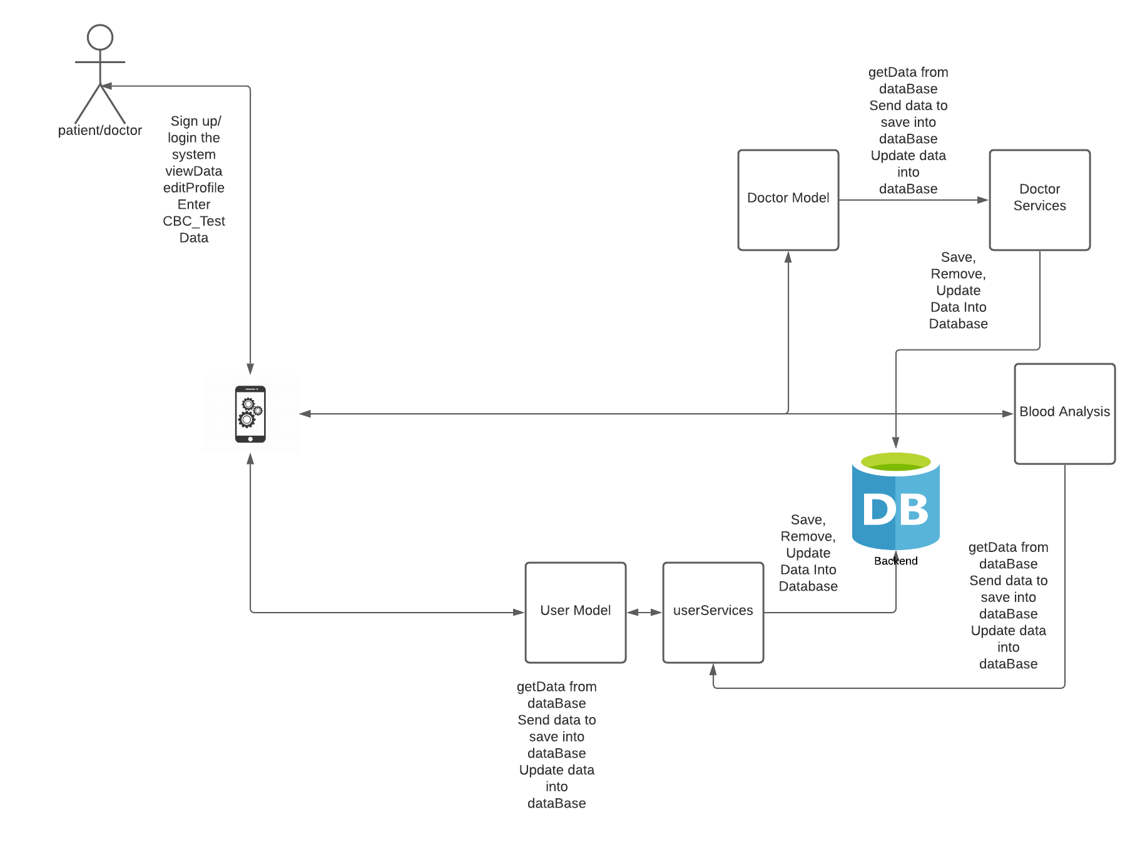
Application Overview
The user can quickly determine whether the patient has corona virus or not, where the system analyze the blood data entered by The patient and sends back a report whether he/she positive .if the patient is diagnosed with COVID-19 , the application will ask the one to see a doctor or provide a communication with any doctor in the application's chat system.

Slide 3
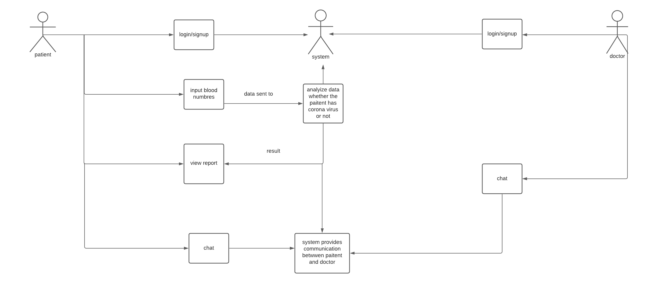
Use case

Slide 4
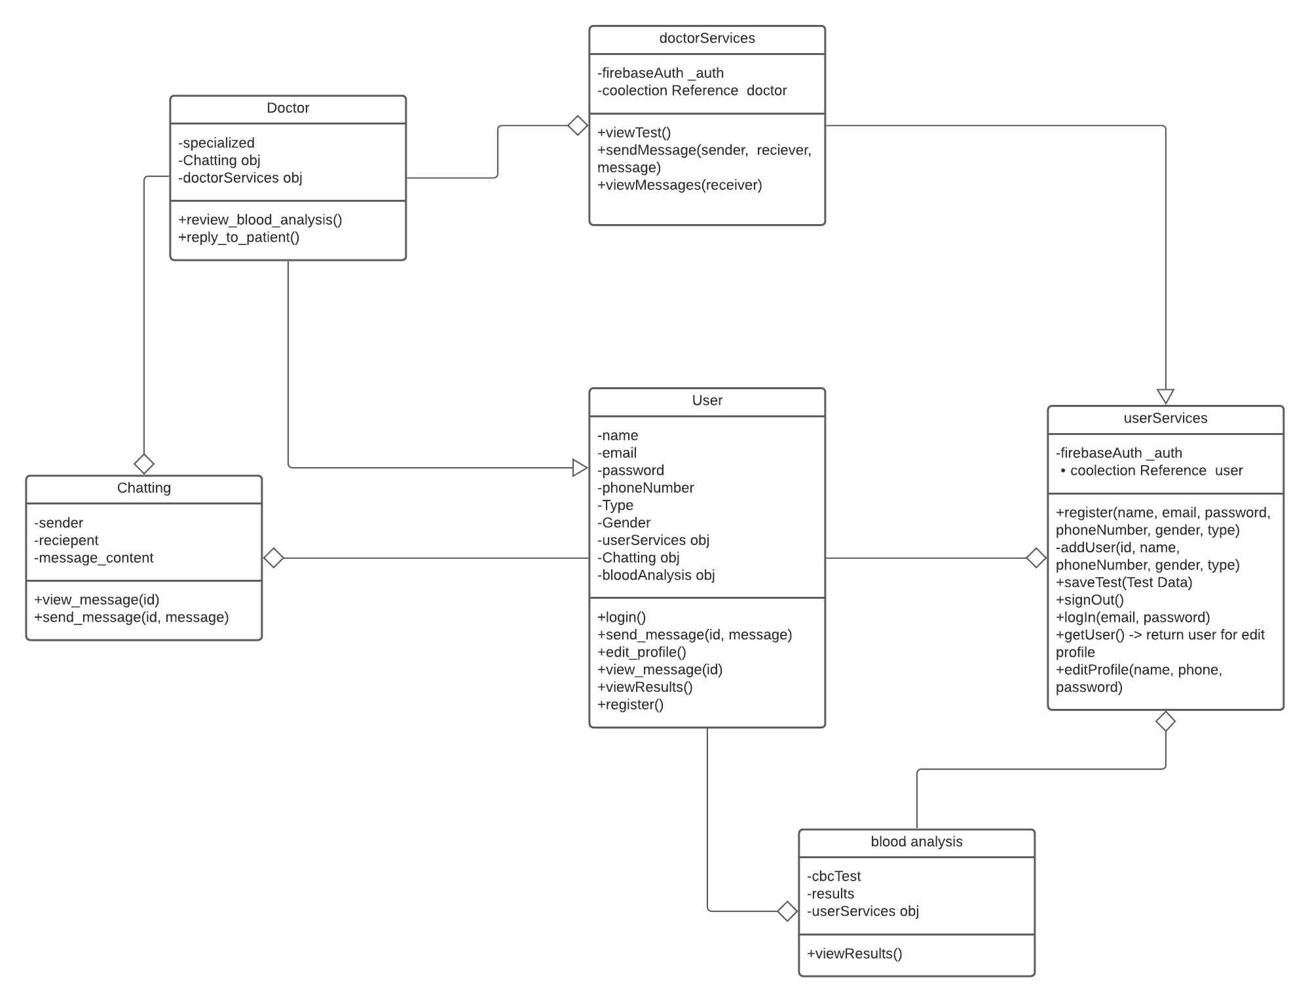
Class Diagram

Slide 5
Depoyment status
https://play.google.com/store/apps/details?id=com.blood.count

Slide 6
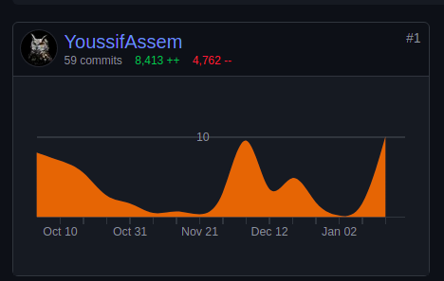
Tasks(Youssif Assem)
Backend All patient Side
1) Rotate Screen 2) Implement User Class 3) Implement user Services Class
4) Implement blood Analysis Class
5) Frontend login and signup and logout
6) Implement Edit profile
7) Examine me CBC Test Frontend
8) Animation to report Screen
9) Report Screen
10) History Screen
11) Validation all patient side
12) Research collect information of cbc test from friend and get pdf
13) Document :
Abstract, revised all diagrams and edited them all, functional requirements, system overview, problem statement, class descriptions

Slide 7
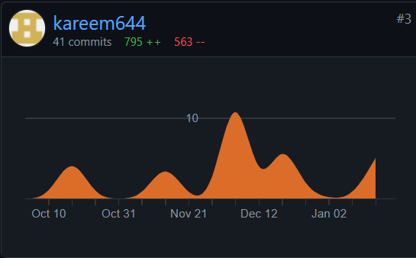
Tasks(Kareem Ehab)
Collected papers for similar systems and evidence for other applications methods
Message #chat-room
Document writing:
user characteristics
similar systems
data description
operational scenarios
user objectives
Non functional requirement
Use case diagram
UI design for most patient Side:
Login UI
Main page UI
3. Edit Profile UI
Research:
Collected papers for similar systems and evidence for other applications methods

Slide 8
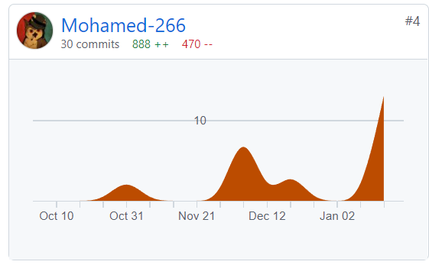
Tasks(Mohamed moataz)
Document writing:
functional requirements
time plan
scope of the document,
purpose of this document
class descriptions
operational scenarios
UI design for most patient Side:
a dynamic bottom navigation bar
validation in examine me
implemented animation in home screen
implemented a splash screen at the start of the application
tried to implement google authenticate

Slide 9
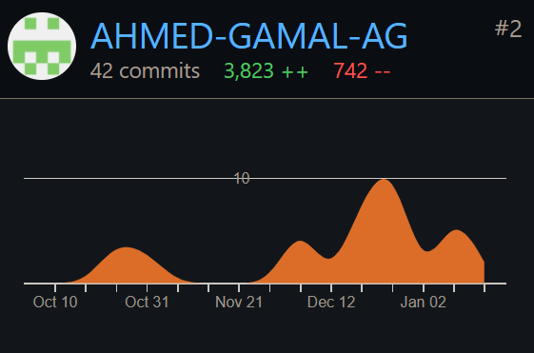
Tasks(Ahmed Gamal)
Document writing:
an inheritance relation ship
Application:
set up firebase Implementing,
chat screen,
Doctor Page front end and backend implementation with link to patient side
Deployment Deploy application,

Slide 10

Demo

Slide 11
Any Questions??

